Slide 1
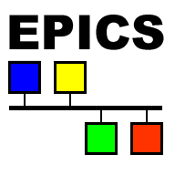
Experimental Physics and Industrial Control System (EPICS)
Dan Crisp
2016-12-15

Slide 2
Acknowledgments
Some slides in this talk came from
EPICS Introduction by Andrew Johnson at APS EPICS Training 2014 and at LBNL 2016
"Accelerator Controls” by Elke Zimoch from PSI at JUAL (Joint Universities Accelerator School) serials
EPICS Training at PSI by Elke Zimoch from PSI
Serial training courses by Bob Dalesio
Overview and Introduction to EPICS from FRIB by Guobao Shen

Slide 3
Outline
What is an accelerator control system?
What is EPICS?
EPICS Control System Architecture
EPICS Channel Access
EPICS IOC (Input Output Controller)
EPICS Record
Solve a Problem in EPICS
EPICS Software Toolkit
The EPICS Community

Slide 4
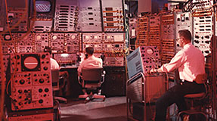
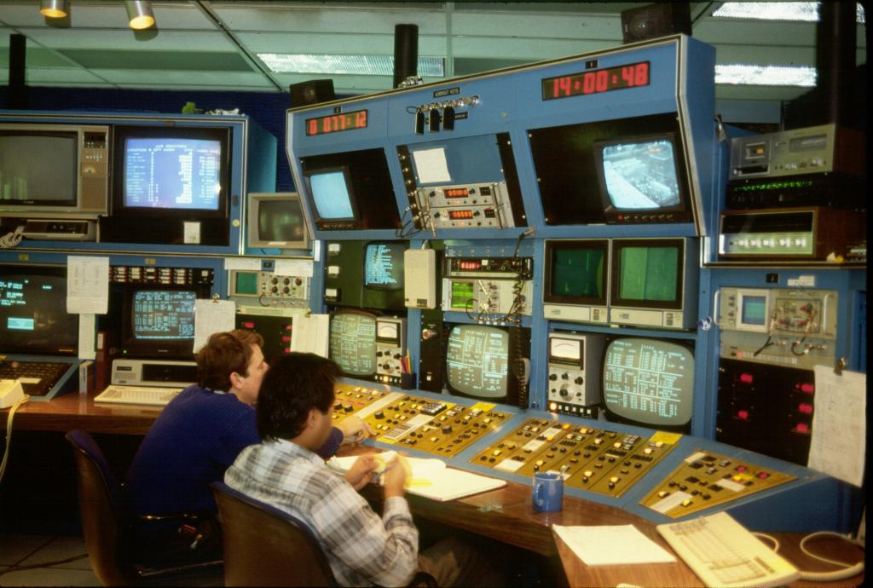
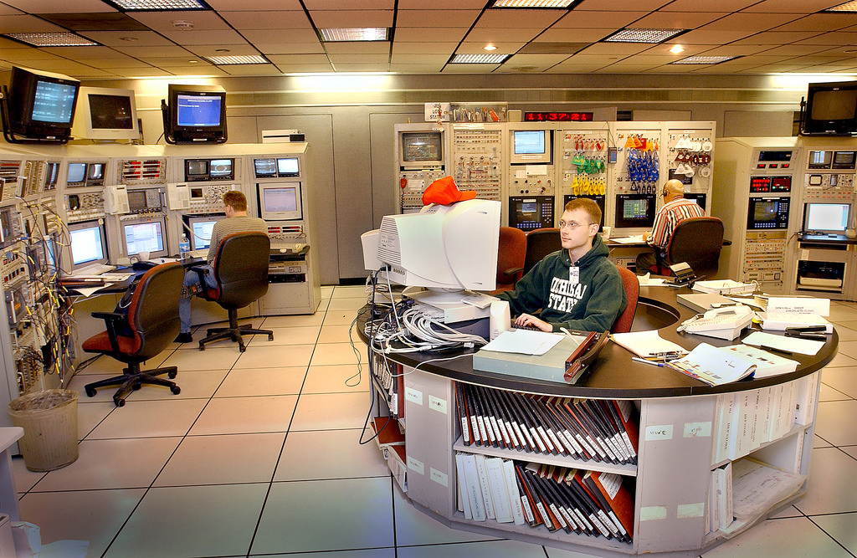
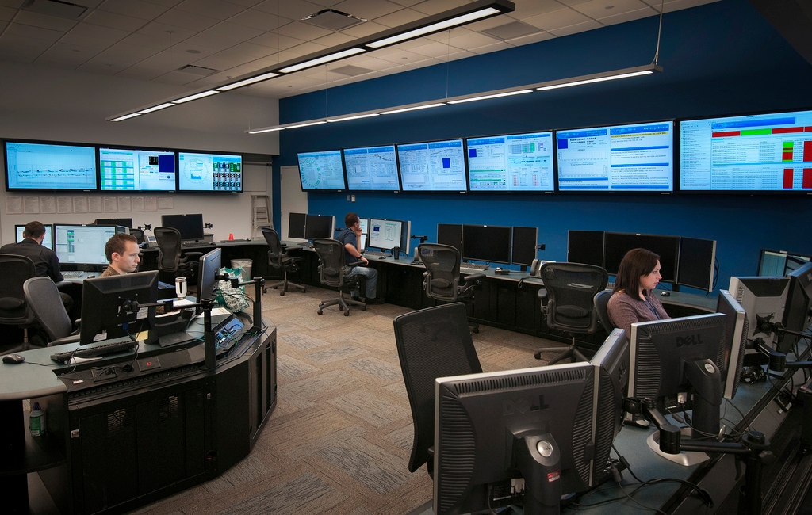
History of Accelerator Controls
AGS, BNL, 1966
Cyclotron, TRIUMF, 1980
RHIC, BNL, 2002
NSLS II, BNL, 2013

Slide 5

What is EPICS?
EPICS (Experimental Physics and Industrial Control System)
a collaboration
a set of software tools and applications
a control system architecture
supports distributed control systems for large research facilities like charged particle accelerators
distributed software over the network
use Client/Server methods
use the Channel Access (CA) network protocol
A collaboration started in 1989 between Los Alamos National Laboratory (GTA) and Argonne National Laboratory (APS)
More than 150 licenses agreements were signed, before EPICS became Open Source in 2004
http://www.aps.anl.gov/epics/
GTA: Ground Test Accelerator
APS: Advanced Photon Source
Notes:
Quote from the EPICS web page (http://www.aps.anl.gov/epics/about.php):
EPICS is a set of software tools and applications which provide a software infrastructure for use in building distributed control systems to operate devices such as Particle Accelerators, Large Experiments and major Telescopes. Such distributed control systems typically comprise tens or even hundreds of computers, networked together to allow communication between them and to provide control and feedback of the various parts of the device from a central control room, or even remotely over the internet.
EPICS uses Client/Server and Publish/Subscribe techniques to communicate between the various computers. Most servers (called Input/Output Controllers or IOCs) perform real-world I/O and local control tasks, and publish this information to clients using the Channel Access (CA) network protocol. CA is specially designed for the kind of high bandwidth, soft real-time networking applications that EPICS is used for, and is one reason why it can be used to build a control system comprising hundreds of computers.

Slide 6






















EPICS Collaboration
EPICS Collaboration

Slide 7

Who uses EPICS (Very Incomplete List)?
Over 150 independent projects on all continents throughout the science community and US industrial applications

Slide 8
What can EPICS do?
Typical Distributed Control System Function (DCS) and satisfy technical environment requirements
Distributed: remote control & monitoring of technical equipment
Data Acquisition: hardware controls including image data acquisition, data conversions and filtering
Real time: soft real time process, support real time operating system (VxWorks, RTEMS, et.al.)
Process control: automatic sequencing of operations, closed loop control like PID controls & feedbacks ( both slow and fast)
Central services: data trending, archiving, retrieval and plotting
Security: channel access security
Time synchronization: time stamps
Others
Alarm detection, reporting and logging
Mode and facility configuration control (save/restore)
Modeling and simulation
Data analysis

Slide 9
EPICS Control System Architecture
Network based Client/Server Model (hence the EPICS logo):
For EPICS, client and server refer to their Channel Access role: i.e. Channel Access Client and Channel Access Server
Standard control system architecture, which is often called
3 tier architecture or 3 layer model
EPICS
A Server provides information and service
A Client uses the service or asks for the information
CA
CA
Client
Client
CA
CA
Server
Server

Slide 10
What is Channel Access?
A protocol how to transfer data over network
A single data unit is called Process Variable (PV)
A PV has a unique name, which is used to refer to the data (Naming convention needed!)
A channel is a live connection to a PV
The detailed operation of Channel Access is unimportant for most programmers (it already works…)
Channel Access is not dependent on a single programming language (native library in C/C++, Java, and C# available)
The entire set of PVs establish a Distributed Real-time Database of machine status, information and control parameters
CAS
CAS
CAS
CAS
CAS
Process
Variables
CAS
CAS
Process
Variables
Process
Variables
Process
Variables
EPICS Database

Slide 11
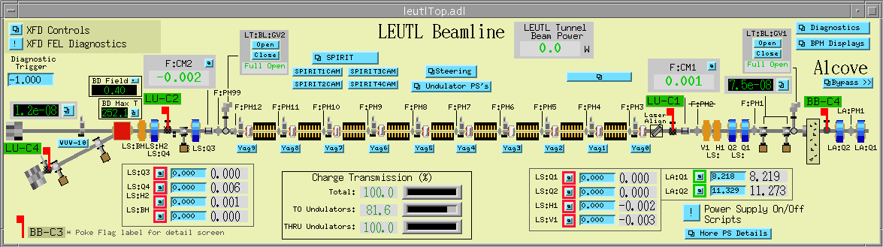
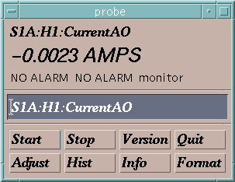
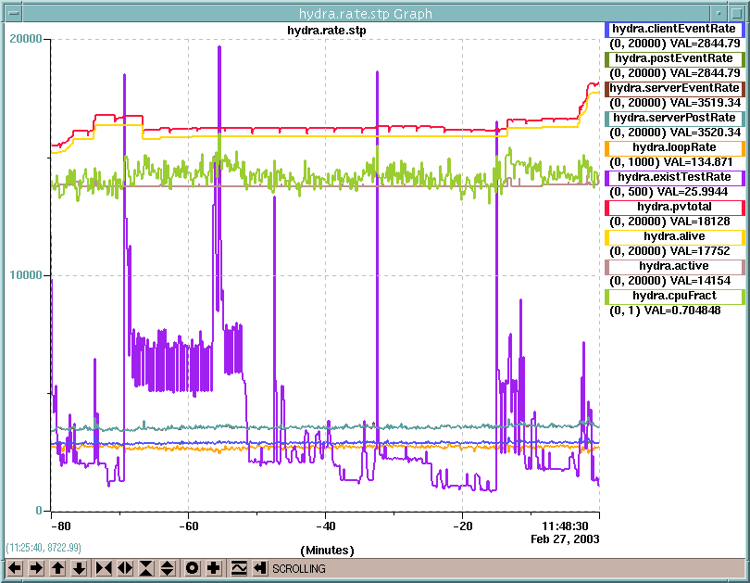
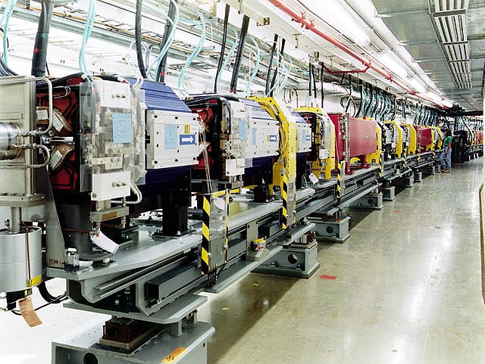
How is it Done?
Channel Access Client
Operator
Channel Access Client
Channel Access Client
Network (Channel Access Protocol)
Channel Access Server
Process Variables:
Computer Interface
Power Supply
S1A:H1:CurrentAO
S1:P1:x
S1:P1:y
S1:G1:vacuum
Beam Position Monitor
Computer Interface
Computer Interface
Vacuum Gauge
Machine

Slide 12
Channel Access Commands
“connection request” or “search request”
“get”
or
“caget”
“put” or
“caput”
“set a monitor”
Change its value to 30.5
Notify me when the value changes
Who has a PV named “S1A:H1:CurrentAO”?
What is its value?
Channel Access Client
CA Client
CA Server
I do.
25.5 AMPS
OK, it is now 30.5
It is now 20.5 AMPS
It is now 10.5 AMPS
It is now 0.0023 AMPS
Channel Access Server
Process Variables:
“put complete”
S1A:H1:CurrentAO
S1:P1:x
S1:P1:y
S1:G1:vacuum
30.5 is too high. It is now set to the maximum value of 27.5.
“post an event”
or
“post a monitor”
or
You are not authorized to change this value
or

Slide 13
What is an IOC?
IOC means: Input Output Controller
A special CA Server and CA Client (IOCs can “talk” to each other)
A computer running the “IOC Core” program (at least once)
This computer may be:
VME, cPCI, uTCA, PC laptop, PC workstation, FPGA, ARM
Running operating system:
vxWorks, RTEMS, Linux, Windows, OSX, Unix, Soft BLADE
An IOC normally is connected to input and/or output hardware (otherwise called softIOC)
An IOC runs a record database, which defines what this IOC is doing
One IOC != One Computer
An IOC is one OS process running on a computer
On single task OS, one IOC == one computer
An computer could run more than one IOC process
Linux, Windows, OSX, and so on

Slide 14
What are Records?
A Record is an object with
a unique name
controllable properties (fields)
contain information (data) different data types can appear in different fields
A behavior - defined by its record type
the ability to perform actions on that data
unique name
XYZ1234
Employee : James Bond
Badge Number: 007
Address : Whitehall, London
Salary : £70070.07
fields
data

Slide 15
Example: View of a Record
record(ao,"DemandTemp") {
field(DESC,"Temperature")
field(ASG,"")
field(SCAN,"Passive")
field(PINI,"NO")
field(PHAS,"0")
field(EVNT,"0")
field(DTYP,"VMIC 4100")
field(DISV,"1")
field(SDIS,"")
field(DISS,"NO_ALARM")
field(PRIO,"LOW")
field(FLNK,"")
field(OUT,"#C0 S0")
field(OROC,"0.0e+00")
field(DOL,"")
field(OMSL,"supervisory")
field(OIF,"Full")
field(PREC,"1")
field(LINR,"NO CONVERSION")
field(EGUF,"100")
field(EGUL,"0")
field(EGU,"Celcius")
field(DRVH,"100")
field(DRVL,"0")
field(HOPR,"80")
field(LOPR,"10")
field(HIHI,"0.0e+00")
field(LOLO,"0.0e+00")
field(HIGH,"0.0e+00")
field(LOW,"0.0e+00")
field(HHSV,"NO_ALARM")
field(LLSV,"NO_ALARM")
field(HSV,"NO_ALARM")
field(LSV,"NO_ALARM")
field(HYST,"0.0e+00")
field(ADEL,"0.0e+00")
field(MDEL,"0.0e+00")
field(SIOL,"")
field(SIML,"")
field(SIMS,"NO_ALARM")
field(IVOA,"Continue normally")
field(IVOV,"0.0e+00")
}
All record fields
have default values
(in case they are not specified by the developer)

Slide 16

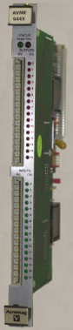

Example Record
IOC
Database
Process
Temperature Sensor
Analog to Digital Converter
record (ai, “MTRT1-TEMP:READ”)
{
field (EGU, “deg C”)
field (EGUL, “0”)
field (EGUF, “100”)
field (HSV, “MAJOR”)
field (HIGH, “51”)
field (SCAN, “.1 second”)
field (DTYP, “Hy8401”)
field (INP, “#C3 S0 @”)
}
Normal Operation
5 - 50°C
0 – 100°C
0 – 10V
8 bit ADC
0 – 10V
0 – 255 bits

Slide 17
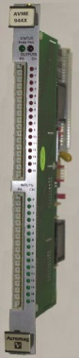


Solve a Problem in EPICS
IOC
ADC
Database
Analog In
MTTR1-LI-COOL:TEMP1
Binary I/O
INP
VAL
Problem:
In the LINAC we have a water chiller that must be turned ON whenever the average temperature of two temperature sensors rises above a set point. The set point is nominally 10 degrees centigrade.
Calculation
Binary out
EGU: deg C
MTRT1-LI-COOL:CALC
Sensor
INPA
MTRT1-LI-COOL:SW
T1
INPB
VAL
DOL
OUT
ADC
C: 10
Analog In
CALC: ( (A+B)/2 ) > C
Chiller
MTRT1-LI-COOL:TEMP2
SCAN: 10 second
INP
VAL
Sensor
EGU: deg C
T2

Slide 18
EPICS CLI Tools
Read a PV named <NAME>
caget NAME
Get information
cainfo NAME
Start a monitor
camonitor NAME
(Cancel with [Ctrl] + [c])
Without argument all commands show some help
Set value to a PV
caput NAME VALUE
caget MTRT1-TEMP:READ
cainfo MTRT1-TEMP:READ
camonitor MTRT1-TEMP:READ
caget
caput DemandTemp 24.0

Slide 19
EPICS Software Toolkit
“Installing EPICS” does not create a control system
The EPICS Software Toolkit consists of hundreds of pieces of software
Some are individual programs for performing specific tasks
Creating and running Graphical User-Interfaces, archiving data, monitoring alarms etc.
Others are code libraries for monitor or control of specific kinds of hardware
IOC device and driver support for COTS equipment (PLCs, oscilloscopes etc.)
Others allow common programming languages and tools to interface with EPICS
C/C++, Perl, Python, Java, Matlab/Octave, C#, LabView etc.
Almost all EPICS code is Open Source (freely usable & modifiable)
EPICS Open License is BSD-like; the GNU GPL and LGPL are also used
An EPICS control system can be made by choosing and configuring existing software
Writing code is often only necessary to fill gaps in the available tools

Slide 20
Leadership is mostly informal
Bob Dalesio, runs Osprey DCS (EPICS Consultancy)
Andrew Johnson, Computer Scientist at APS, Argonne
Leadership is mostly informal
Bob Dalesio, runs Osprey DCS (EPICS Consultancy)
Original author of GTACS and EPICS
Community development
Organizes collaboration meetings
Andrew Johnson, Computer Scientist at APS, Argonne
Manages website, mailing lists etc.
Maintenance lead for EPICS Base (V3)
3 public mailing lists
tech-talk is the main user list
core-talk is for core developers
pvdata-devel is for V4 developers
Open to anyone
tech-talk has 800 subscribers
Questions asked at all levels
Members are usually very helpful
Posts from non-members are moderated to discourage spam
High signal/noise ratio
GNU Mailman handles subscriptions, moderation, daily digest
Searchable archives back to 1994
RSS Feeds of messages

Slide 21
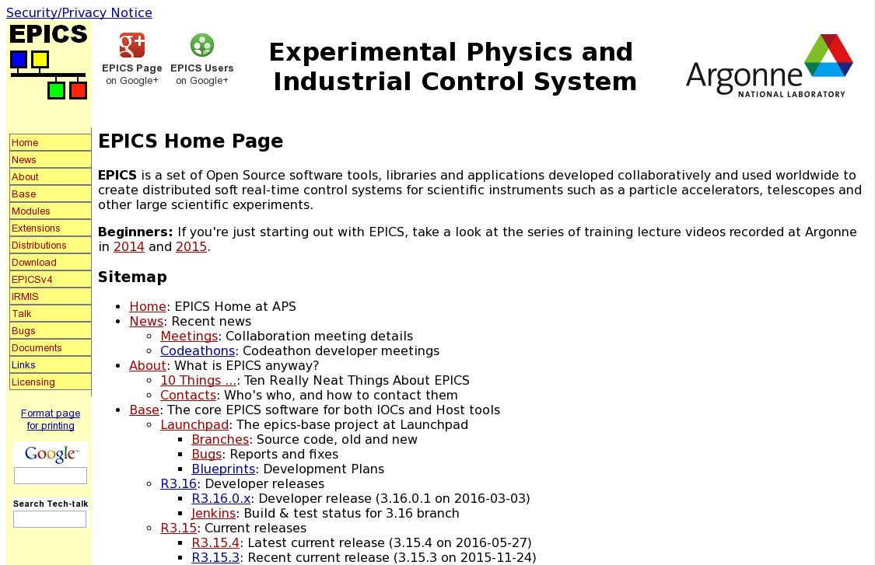
EPICS Resources
Central site for EPICS
http://www.aps.anl.gov/epics/
Documentations
CA Clients
Device support (driver)
Tech-talk (mailing list and archive)
Useful links for trainings
http://www.aps.anl.gov/epics/docs/training.php
http://www.aps.anl.gov/epics/docs/GSWE.php
http://epics.web.psi.ch/training/downloads

Slide 22
EPICS Process Database
Process Block execution time varies from block type to block type
AI on a PowerPC ~100,000/second (50% idle)
AI on a 68060 is ~18,000/second (50% idle)
Fastest periodic scan rate is dependent on OS clock tick – 1 KHz
Interrupt scanning is limited by the CPU bandwidth (interrupt delay ~15usec)
Name resolution - 100,000/second - runs at the lowest priority
Support to particular physical I/O is distinct from process logic - ASCII device type
The numbers are just example with extremely old CPU, and probably no longer meaningful to a modern computer.

Slide 23
Backup

Slide 24


Record Processing
Record processing can be periodic or event driven:
Periodic: Standard scan rates are…
10, 5, 2, 1, 0.5, 0.2 and 0.1 seconds
Custom scan rates can be configured up to speeds allowed by operating system and hardware
No precise timing!
Event driven: Events include
Hardware interrupts
Request from another record via links
EPICS Events
Channel Access Puts
Record Processing means:
Trigger Record to do what it is configured to do.

Slide 25
Solve a Problem in EPICS
The major software components of an IOC (IOC Core)
Inside an IOC
LAN (Network)
IOC
Channel Access
Process Database
Sequencer
Device Support/Device Driver
I/O Hardware

Slide 26
EPICS Process Database
LAN
A collection of EPICS record(s)
Process Blocks are the basic elements: AI, AO, BI, BO, Motor, CALC, PID, SUB, etc.…
Process Blocks consist of fields for: SCHEDULE, I/O, CONVERT, ALARM, MONITOR
They hold runtime values: VALUE, TIMESTAMP, ALARM CONDITION, etc.…
New process block are easily added
Configured using Text Editor or some EPICS tools like VDCT, GDCT
Loaded as ASCII records at boot time
All fields can be read/written through the channel access client interface during operation
ca-client
ca-server
Process DB
Device support
Driver support
Device Driver

Slide 27
Community Organization
Leadership is mostly informal
Bob Dalesio, runs Osprey DCS (EPICS Consultancy)
Original author of GTACS and EPICS
Community development
Organizes collaboration meetings
Andrew Johnson, Computer Scientist at APS, Argonne
Manages website, mailing lists etc.
Maintenance lead for EPICS Base (V3)
Various development groups exist and have their own leadership
EPICS Core Developers (Andrew Johnson)
EPICS V4 Working Group (Bob Dalesio and Andrew Johnson)
Control System Studio (Eric Berryman, FRIB at MSU)
Distributed Information Services for Control Systems (Dylan Maxwell, FRIB at MSU)
AreaDetector (Mark Rivers, Uchicago)
Occasional meetings of management of the main labs to discuss effort & direction

Slide 28
Mailing Lists
3 public mailing lists
tech-talk is the main user list
core-talk is for core developers
pvdata-devel is for V4 developers
Open to anyone
tech-talk has 800 subscribers
Questions asked at all levels
Members are usually very helpful
Posts from non-members are moderated to discourage spam
High signal/noise ratio
GNU Mailman handles subscriptions, moderation, daily digest
Searchable archives back to 1994
RSS Feeds of messages

Slide 29
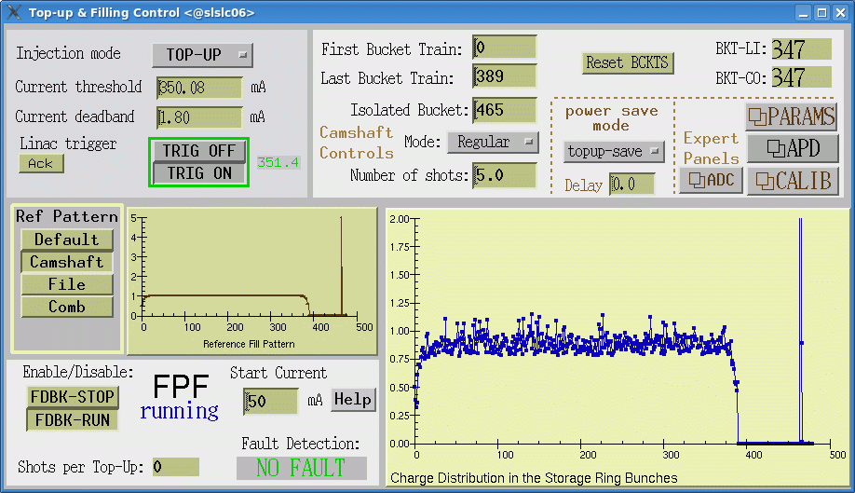
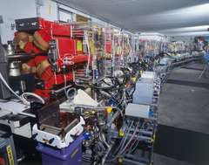
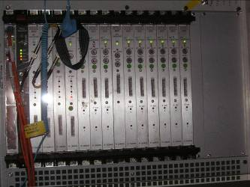
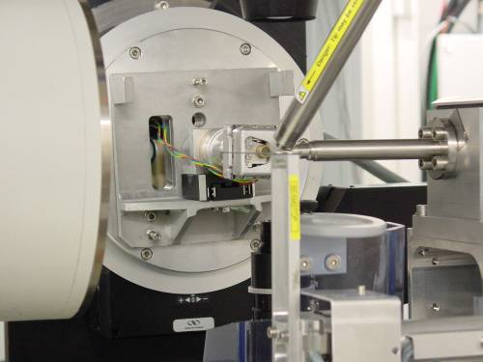

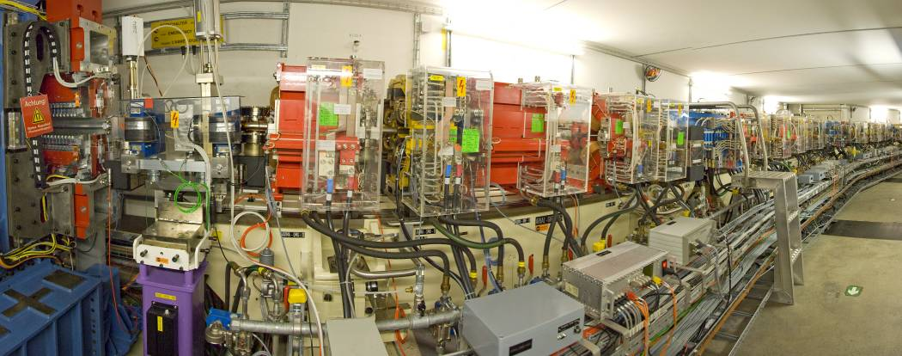
What is an Accelerator Control System?
A computer environment to solve simultaneously requirements of different user groups to run an accelerator
Connect the Operator in the control room with the accelerator hardware. The control room might not be near the accelerator
Control System
Operator in Control Room
Notes:
The Accelerator Control System connects the Operator in the control room with the accelerator hardware. The control room might not be near the accelerator:
-SLS is 200m away from PSI main control room -For SwissFEL the control room will be a kilometer away -Some experiments are controlled remote from all over the world

Slide 30
What is an Accelerator Control System? Technical Environment
Control Systems (one way or another) have to deal with …
Distributed end points and processes
Geographically over for example miles
Hundreds of thousands of signals, millions of process variables
Data Acquisition (front end hardware)
Real-time needs (where necessary)
Process control (automation, feedback, PID controller)
Central Services (Archive, Databases, Name Resolution)
Data transport (control system protocol, network)
Security (who’s allowed to do what from where?)
Time synchronization (time stamps, cycle ids, etc.)
that is: Computers (in different flavors) and Computer Environment

Slide 31
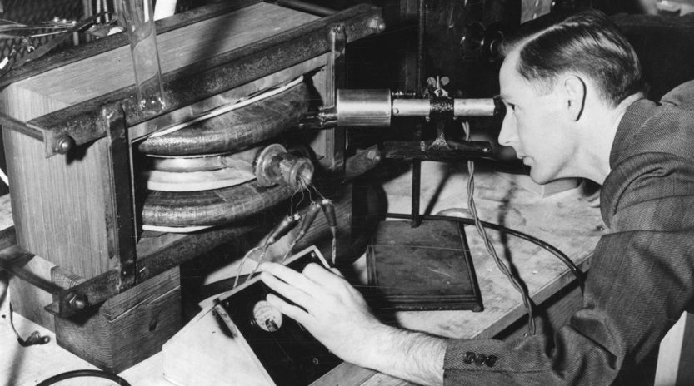
History of Accelerator Controls
Accelerator Control System
Diagnostics
Settings
Prof Donald Kerst with the first betatron invented in 1940 at the University of Illinois
Notes:
No Control System needed because:
-Direct tuning with knobs -Direct diagnostics with own eyes -(Very) limited number of devices involved
-> so the brain is the Accelerator Control System in this case

Slide 32
Solutions: Different Control System Examples
System Name:
EPICS
TANGO
DOOCS
ACS
SCADA (PVSS)
Collaborations:
Used at more than one Lab
Pro:
Bugs are already found
Cons:
Learning curve to adapt
to your problems
Single Site Systems:
Developed and used in one Lab
Pro:
Your problems solved
perfectly
Cons :
You are on your own
(no one can help)
Commercial System
Pro:
Outsource your problems
Cons :
Expensive
Notes:
SCADA = Supervisory control and data acquisition
Best solution: all systems are used somewhere to control accelerators successful.
All systems support good experiments and produce excellent science.
Therefore, the choice of system is political not technical.

Slide 33
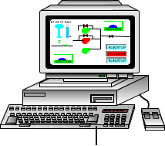
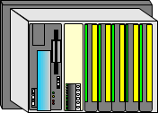
EPICS Supports Standard Control System Model
OS:
Unix/Linux
Windows
Site LAN/WAN
I/O Controllers:
VME,VXI
PCI, PCIe, uTCA, PLC,
Softcores on FPGAs
OS:
vxWorks, Unix, Windows
RTEMS, RTLinux, Linux
Remote and Local I/O Buses:
Control Net, PCI, CAN-Bus, Industry Pack, VME, VXI, PCI, ISA, CAMAC, GPIB, Profibus, Bitbus, Serial, Modbus, Yokogawa, G-3, Ethernet/IP, RS232,
Many more….
Instruments
Instruments
Instruments
Notes:
Three-tier standard model for distributed control systems.
The hardware layer was considered dumb when the terminology was developed.
Meanwhile “hardware” can be as complicated as a robot (with its own controller) or an oscilloscope (with an operating system installed on a specialized computer).
More and more logic is moved to the hardware layer.

Slide 34
Channel Access Network Flow
1. Query: Broadcast
CA Client
2. Answer: direct connection
3. All further queries and answers work directly (Point-To-Point)
Network
CA Server 1
CA Server 2
CA Server 3

Slide 35
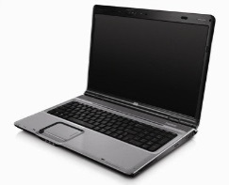
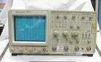
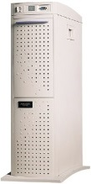
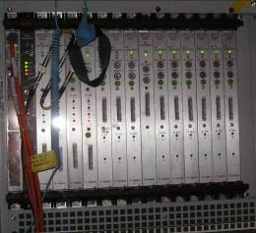
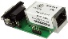
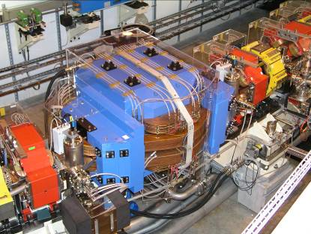
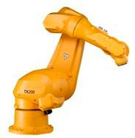
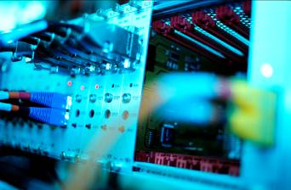
Parts of EPICS
CA Client
CA Client
Client Programs:
Alarm, Striptool, CS-Studio,
many more …
(user programs)
Control Room
Channel Access:
(UDP/TCP)
Output
Input
CA Server
CA Server
IOC
Server Programs:
(user programs)
Realtime Control
Records
Hardware: maybe
controllers and PLCs

Slide 36
Close Look at a Measured Value
Value with a data type
295.5
with a unit mA
with a time stamp 17.2.2005 14:21:16
with a severity (alarm state) NO_ALARM
with technical limits 0 to 400
with graphical limits 0 to 370
with a description "Beam current in SR"
A measured value is an object with multiple related information
that have different data types.
One object is called an EPICS record

Slide 37
Make a Record from a Measured Value
record (ai, "ARIDI-PCT:CURRENT") {
with a unique name ARIDI-PCT:CURRENT
Configured by developer
A value with a data type
295.5
ai
field (EGU, "mA")
field (EGUF, "400")
field (EGUL, "0")
with a unit mA
with a time stamp
17.2.2005 14:21:16
field (HOPR, "370")
field (LOPR, "0")
with a severity (alarm status)
NO_ALARM
field (DESC, "Beam current in SR")
with technical limits 0 to 400
field (DTYP, "HY8401")
field (INP, "#C3 S0 @")
with graphical limits 0 to 370
}
with a description "Beam current in SR"
Read back from hardware/driver
VAL
SEVR
TIME

Slide 38
Process Variable (PV)
A PV name is comprised of two parts
The record name, and
the name of a field belonging to that record
For example…
Note that if no field name is given, Channel Access will default to using the .VAL field “ARIDI-PCT:CURRENT” is interpreted as “ARIDI-PCT:CURRENT.VAL”
As well as a value, a PV has other attributes, e.g.
Engineering units string, Timestamp, Alarm status and severity
Operating range (Low .. High)
Control limits (Low .. High)
that means: most record fields can be accessed individually
ARIDI-PCT:CURRENT
.
EGU
A Process variable name
A record name
A dot to join them
A field name

Slide 39
What do Records do?
Depends on
Record Type
Field values
Records are active, they do things
Get data from other records or from hardware
Perform calculations
Check values are in range and raise alarms
Put data to other records or to hardware
Activate or disable other records
Wait for hardware signals (interrupts)
record do nothing until they are processed
Analog in
Analog out
Binary in
Binary out
Calculation
Calculation out
Compression
Data fanout
Event
Fanout
Histogram
Motor
Multi bit binary input
Multi bit binary output
PID control
Pulse counter
Pulse delay
Scan
Select
Sequence
String in
String out
Subarray
Subroutine
Waveform
incomplete
list!

Slide 40
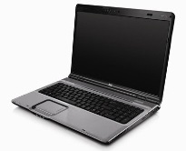
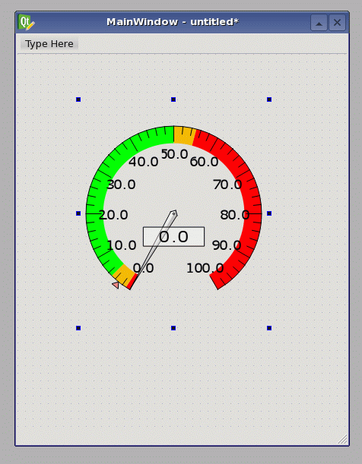
Example Record
CS-Studio sets a CA monitor
CA Client: CS-Studio
every time the value changes record triggers callback
IOC
Record Support
record (ai, “MTRT1-TEMP:READ”)
{ …
field (SCAN, “.1 second”)
field (DTYP, “Hy8401”)
field (INP, “#C3 S0 @”)
field (VAL, “34”)
… }
Device Support
every 0.1 seconds the record asks the driver for a value
Driver
and the driver reports back
Value (34 °C)

Slide 41
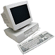
EPICS Software Toolkit
Client Programs
CS-Studio BOY Archive Appliance BEAST Python Olog
Network Protocols Channel Access pvAccess
IOC Software
PV Database State Programs StreamDevice asynDriver synapps areaDetector mca motor sscan caputRecorder softGlue modbus autosave
IOC
IOC
CAS
IOC
pvaSrv
IOC
Network Attached Devices
Commercial Instruments
Custom Chassis/Panels
Server Applications
CA Gateway pcaspy
Technical Equipment

Slide 42
Another View of EPICS Architecture
User Tools
DM/MEDM/DM2K/EDM/JDM
Control System studio,
Alarm Handler / stripTool/
knobManager
Physics Toolkits
Experiment Toolkits
Archive Viewing
Archive Analysis
Program Interfaces
C, C++, Fortran, JAVA
IDL / Matlab / Mathematica
ActiveX / DDE / VisBasic
SDDS / SAD /
tcl / PERL / Python
State Notation Lang / FSQT
Archive Access
Archiving
Channel Access Client (CAC)
Connection Data Transfers
Connection Server
WAN/LAN/Local
Connection Data Transfers
Channel Access Server (CAS)
EPICS Process Database
DB Engine
Types
Device Support
Integrate other systems
Like Labview or legacy
systems
Driver Support
I/O Controller

Slide 43
10 Really Neat Things About EPICS
It is free
It is Open Source
There are lots of users
All a client needs to know to access data is a PV name
You can pick the best tools out there …
… or build your own
The boring stuff is already done
There is a lot of expertise available close by
A good contribution becomes internationally known
It does not matter, if you need 10 or 10 million PVs
It is fun

Slide 44
Review of EPICS Terminology
EPICS: a collaboration, a set of software tools and applications, and a control system architecture
Channel Access: a protocol to transfer data over network
IOC: Input Output Controller, one IOC != one computer
Record: an object with a unique name and various fields
Process database: collection of record(s)
PV: process variable, one PV == oneRecordName.field, field by default is VAL
Channel: a live connection to a PV

